Slide 1
Investigating Terry Stops
Kevin Macias-Matsuura

Slide 2
Amendment IV
Chief Justice Earl Warren
The right of the people to be secure in their persons, houses, papers, and effects, against unreasonable searches and seizures
TERRY
v.
OHIO
The infringement on personal liberty . . . can only be 'reasonable' under the Fourth Amendment if we require the police to possess 'probable cause'

Slide 3
Big Questions
Big Methods
Can we use data analysis to illuminate possible areas of bias when making stops based on probable cause?
If we can see a disproportionate application of stops leading to arrests, what can we do to begin to address an uneven application of the law?
Binary Classification
Prediction: Did a Terry Stop end in an arrest?

Slide 4

Data
Features
Stop Resolution
Subject Age Group
Weapon
Officer Age
Officer Gender
Officer Race
Subject Race
Subject Gender
Call Type
Frisk
Beat
Year of Stop
Seattle’s Open Data Program (2015 -2019)
Post-Cleaning: 28,530 Terry Stops
Most variables nominal/categorical
Dummy variables used as to not place “value”
*
*
Discrete values
*

Slide 5
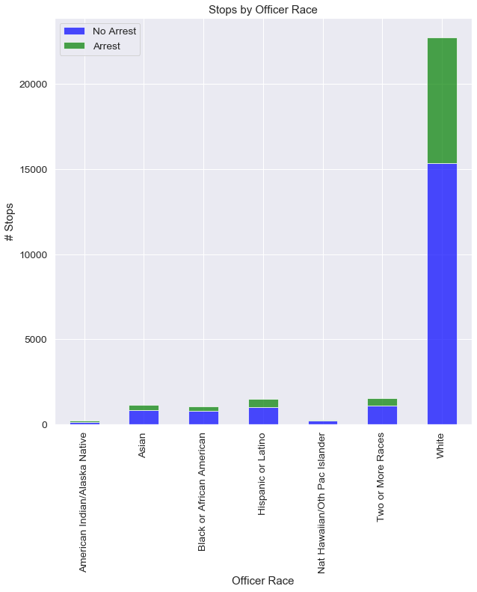
Stops Made By Officer Race
Officer Race | % Stops => Arrest
Hispanic | 33
White | 32
American Indian/Native Alaskan | 32
Mixed | 29
Asian | 26
Black | 25
Pacific Islander | 24

Slide 6
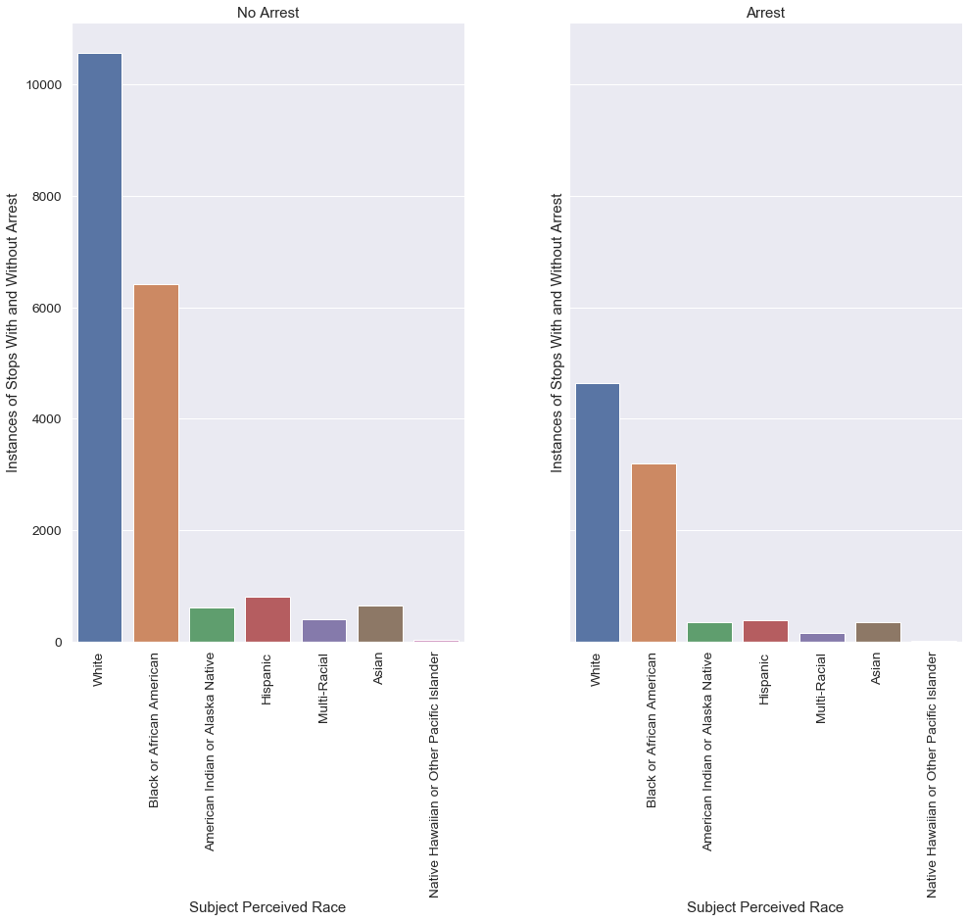
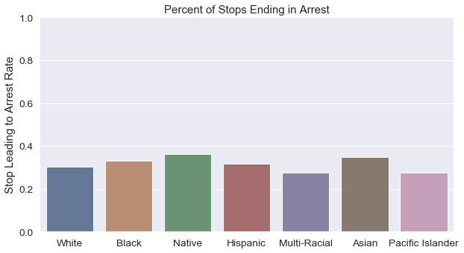
Arrests By
Subject’s Perceived
Race
Stops leading to arrests by the subjects’ perceived race are roughly the same proportionally

Slide 7
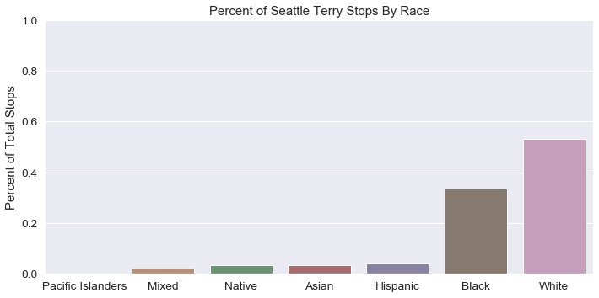
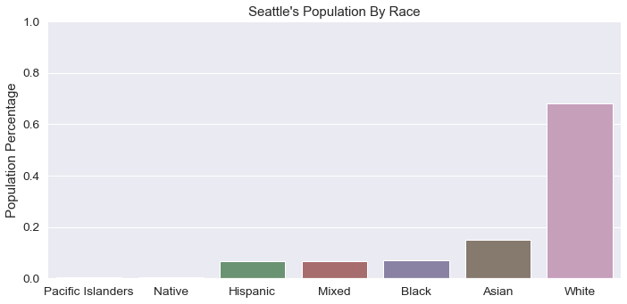
Stops & Population
By Subjects’
Perceived Race
Blacks stopped at 4.81 times the population percentage
American Indian and Alaskan Natives stopped at 5.5 times the population percentage

Slide 8
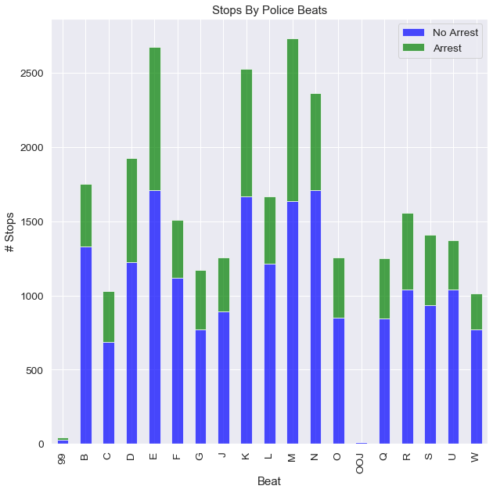
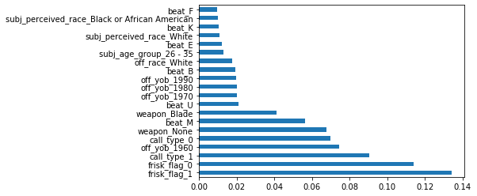
Police Beats
Feature Importance
Beat K
Beat E
Beat M
E
K
M

Slide 9
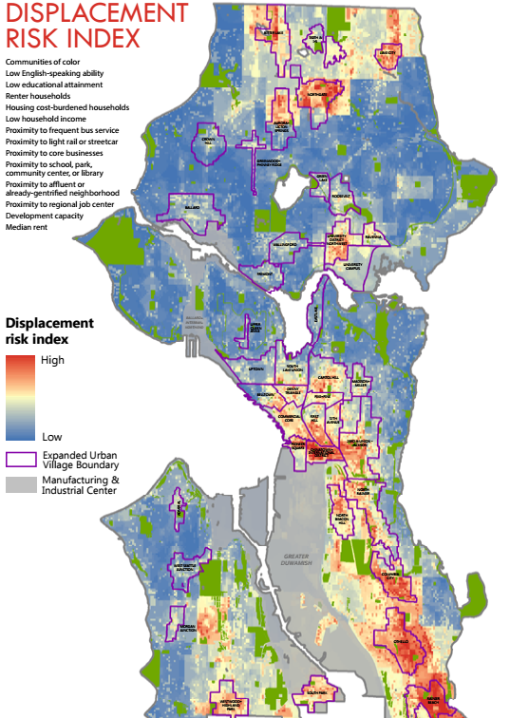
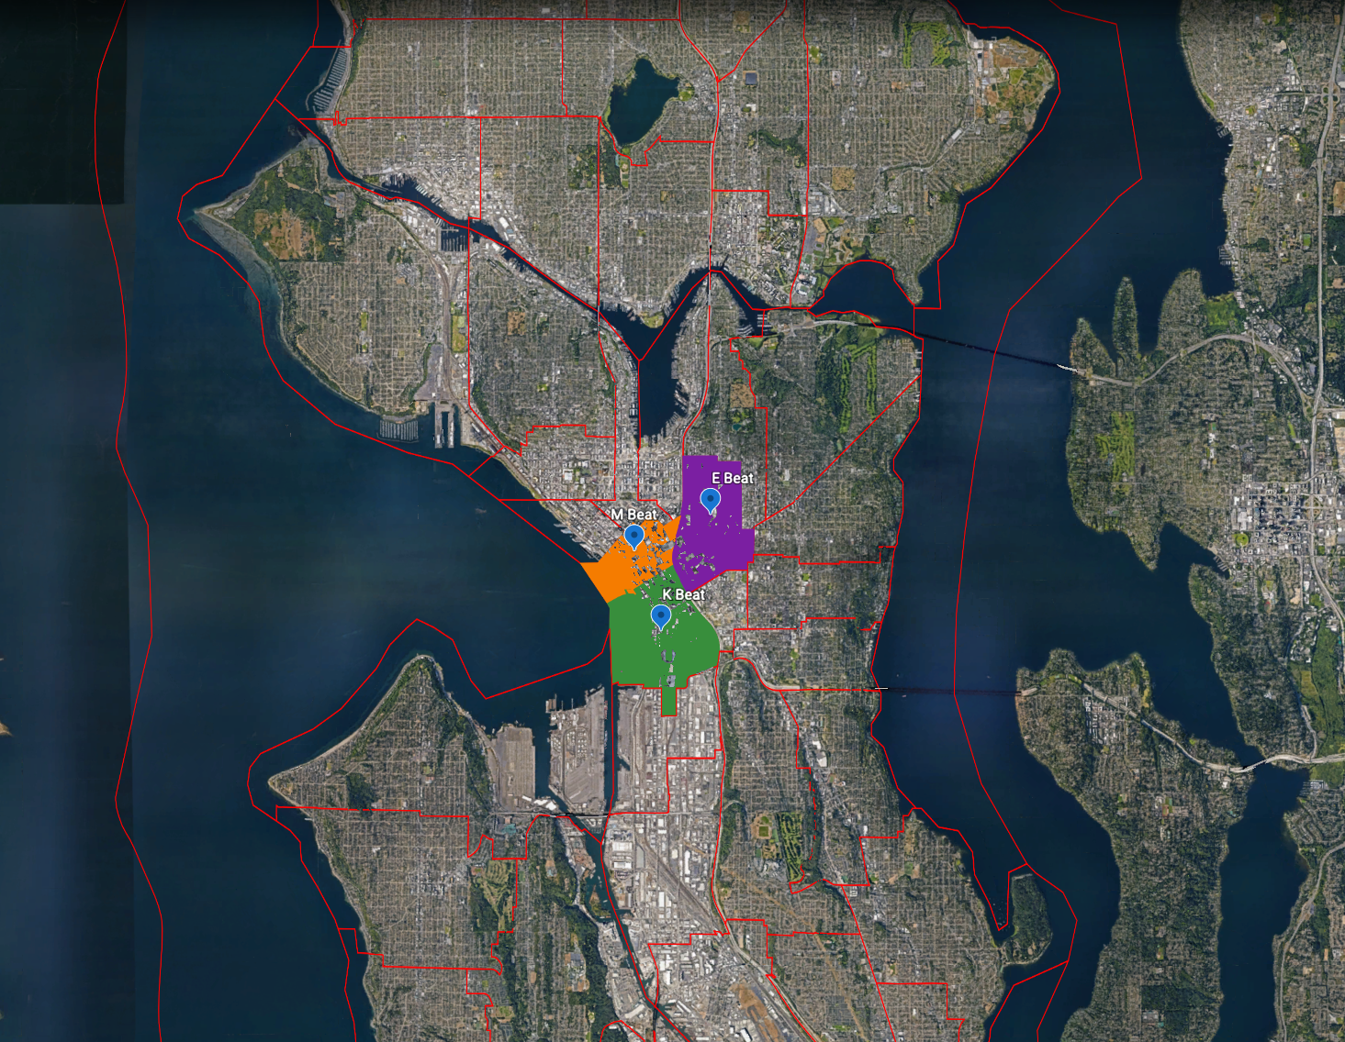
Police Beats
City of Seattle Department of Planning & Development (source)

Slide 10
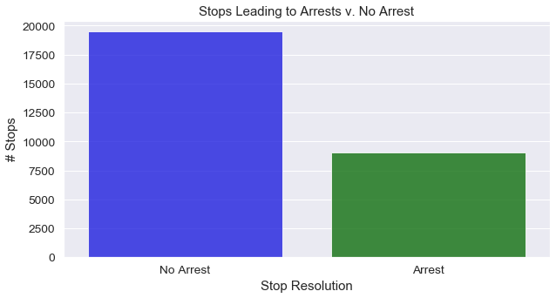
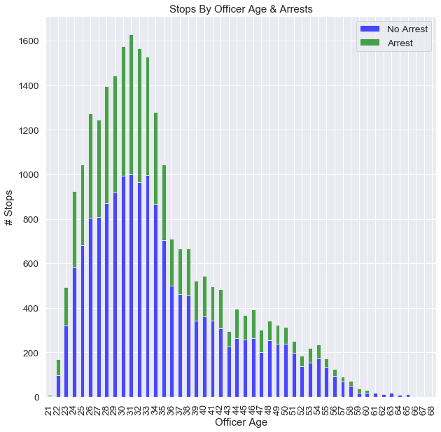
Metrics & Model Selection
Precision & F1
Avoid false positives (no false assumptions)
Logistic Regression (GridsearchCV)
Quick and interpretable coefficients
Random Forest Classifier (GridsearchCV)
Interpretable with feature importance
Handle Class Imbalance: SMOTE
Handle skew in nominal features: StandardScaler( )

Slide 11
Scores & Features
 | Metric | Scores
RFC #1 | F1 | 0.438
 | Precision | 0.400
RFC #2 | F1 | 0.452
 | Precision | 0.425
RFC #3 | F1 | 0.461
 | Precision | 0.418
“Stupid” classifier predicted majority at 67% accuracy.
 | Metric | Scores
Log Regression #1 | F1 | 0.458
 | Precision | 0.416
Log Regression #2 | F1 | 0.457
 | Precision | 0.381
Log Regression #3 | F1 | 0.476
 | Precision | 0.369
Coefficients along with p-value used to feature select for logistic regression.
Feature importance used to feature select with Random Forest

Slide 12
Final Model: Random Forest with GridsearchCV
Best Estimator
bootstrap=True, ccp_alpha=0.0,
class_weight='balanced',
criterion='gini',
max_depth=40,
max_features='auto',
max_leaf_nodes=None,
max_samples=None,
min_impurity_decrease=0.0,
min_impurity_split=1e-05,
min_samples_leaf=1,
min_samples_split=2,
min_weight_fraction_leaf=0.0,
n_estimators=350,
n_jobs=None,
oob_score=False,
random_state=None,
verbose=0,
warm_start=False
Feature Importance
off_age 0.556938
date 0.178606
call_type_1 0.036207
call_type_0 0.030508
off_race_White 0.030083
weapon_Blade 0.026195
subj_perceived_race_White 0.026116
subj_perceived_race_Black or African American 0.025894
beat_K 0.020951
beat_E 0.019318
beat_M 0.018915
beat_F 0.017157
beat_U 0.013110
Scores
F1: 0.4616
Precision: 0.4181

Slide 13
Takeaways & Actionable Steps
American Indians and Alaskan Natives are stopped at 5.5 times their percentage of the population in Seattle which is more than any other group. At only 0.6% of the population, community outreach programs could prove fruitful.
Beats that ranked high in feature importance and where the most stops were made are located in high displacement risk areas. This could possibly be connected to housing/homelessness issues.

